Slide 1
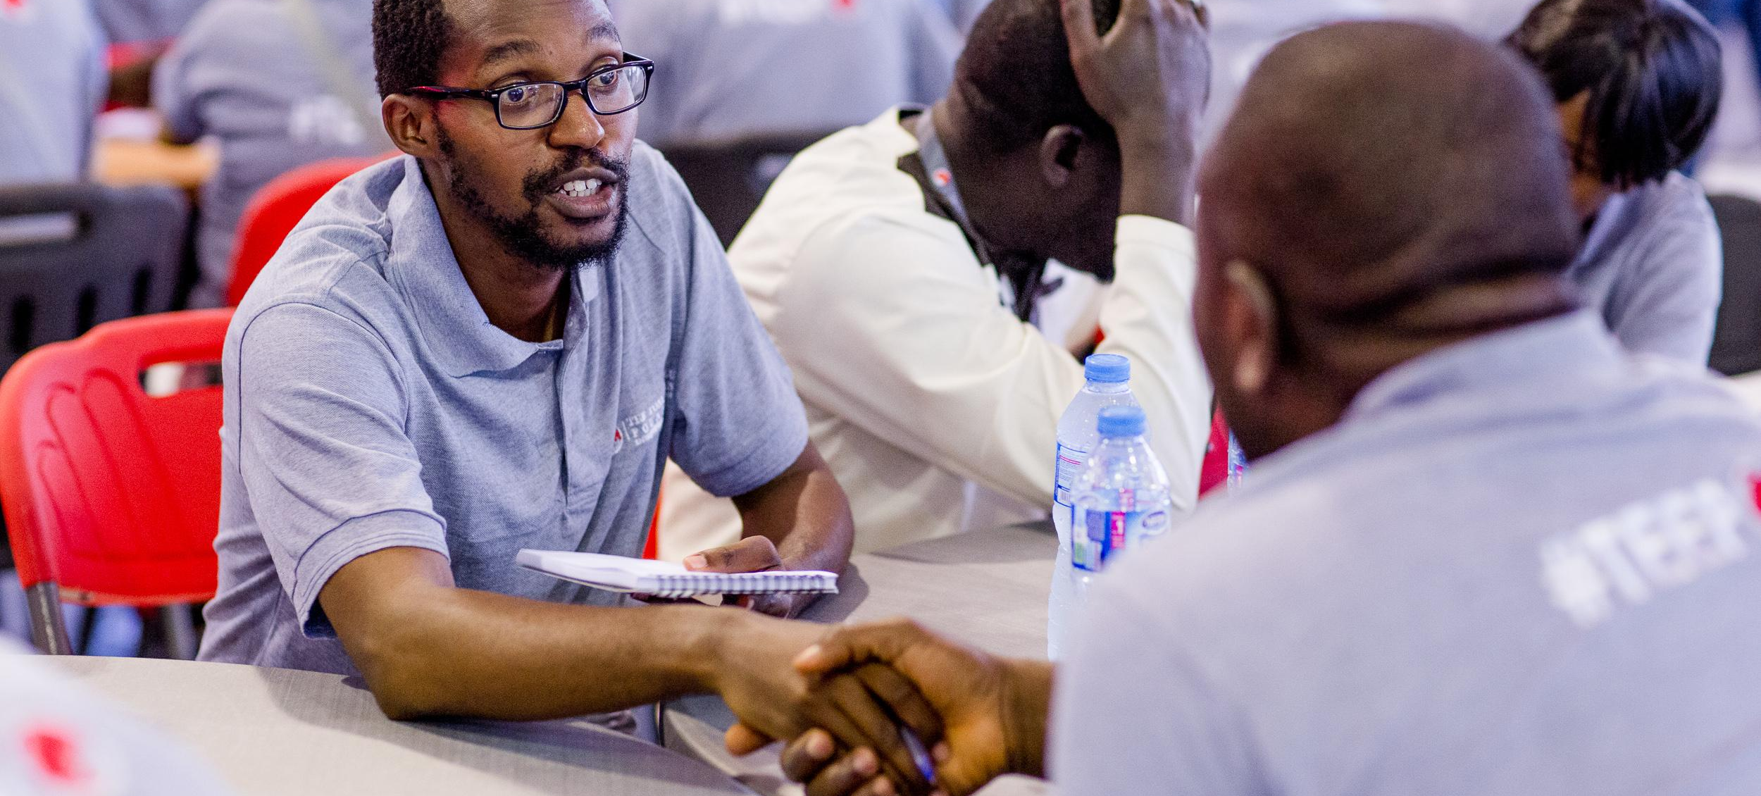

The Tony Elumelu Foundation
Empowering African Entrepreneurs to catalyse economic growth, drive poverty eradication, and ensure job creation
www.tonyeleumelufoundation.org

Slide 2
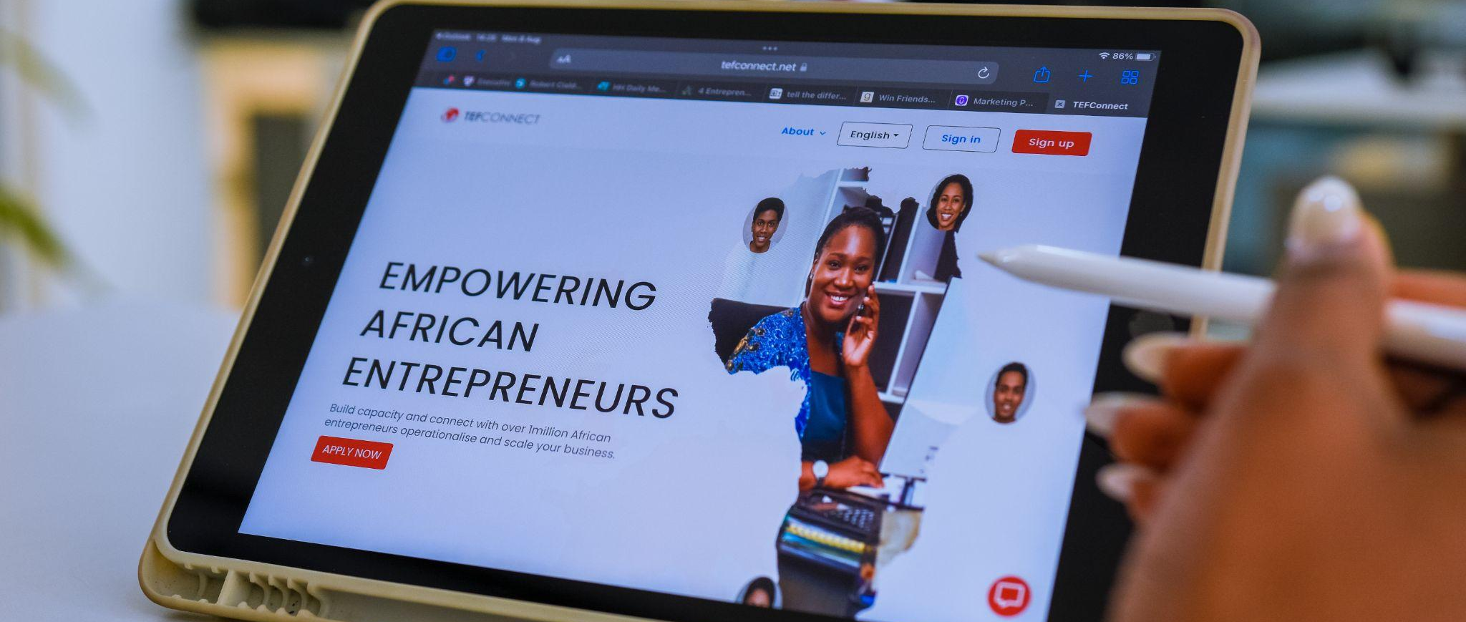
TEF is driving impact…
The Tony Elumelu Foundation
The Tony Elumelu Foundation is the leading philanthropy empowering a new generation of African entrepreneurs, driving poverty eradication, catalysing job creation across all 54 African countries, and increasing women economic empowerment. Since the launch of the TEF Entrepreneurship Programme in 2015, the Foundation has trained over 1.5 million young Africans on its digital hub, TEFConnect, and disbursed up to USD$100 million in direct funding to 20,000 African women and men, who have collectively created over 400,000 direct and indirect jobs.

Slide 3

INTRODUCTION
Founded by African investor and philanthropist, Tony O. Elumelu (CFR), the Tony Elumelu Foundation represents his personal commitment to creating a new generation of entrepreneurs, through his investment company, Heirs Holdings.
We believe the private sector’s role, especially that of young entrepreneurs, is critical for Africa’s development, and that the private sector must create both social and economic wealth.
Our mission is implemented through our programmes, policy, research, advocacy and convenings, including the annual TEF Entrepreneurship Forum, the largest gathering of African entrepreneurs in the world, and TEFConnect, the largest digital networking platform for African entrepreneurs.
The Foundation leverages its strong relationships in the public, private and development sectors to drive its mission of creating prosperity for all.
The Tony Elumelu Foundation is the leading philanthropy empowering African entrepreneurs from all 54 African countries, catalysing economic growth, driving poverty eradication, and ensuring job creation on the continent.

Slide 4

OUR PHILOSOPHY
#Africapitalism embodies the private sector’s commitment to the economic transformation of Africa through long term strategic investments in key sectors that generate economic prosperity and social wealth.

Slide 5

0ver 20,000 African Entrepreneurs across 54 African Countries, have received $5,000 seed capital each to scale their businesses.
TEF
Luck!
Democratising
The Tony Elumelu Foundation recognises that the Entrepreneurs and SMEs are the engines of economic transformation in Africa. It is with this recognition and our Founder’s philosophy of Africapitalism that a US$100million commitment was made in 2015 to identify, train, mentor, and fund 10,000 African entrepreneurs over a 10-year period through the TEF Entrepreneurship Programme.
Today, this commitment has not only been fulfilled, it has been doubled.

Slide 6



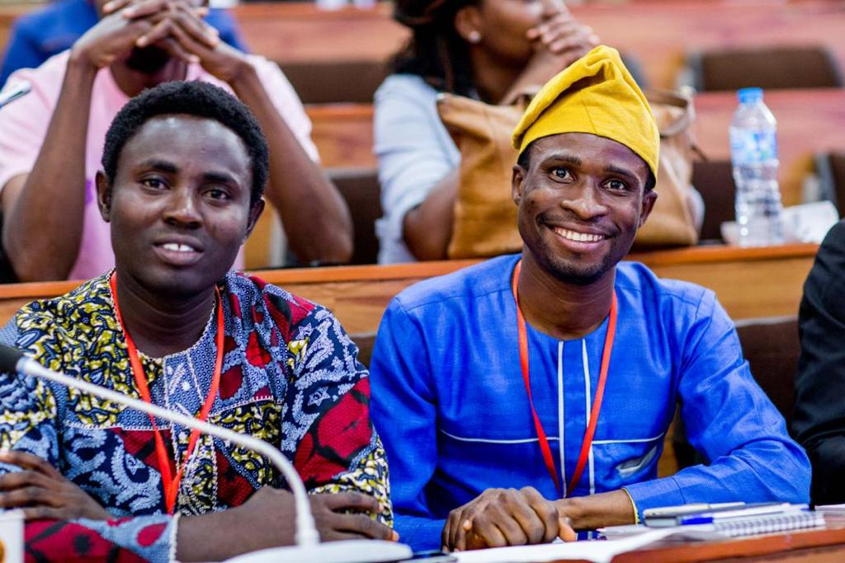
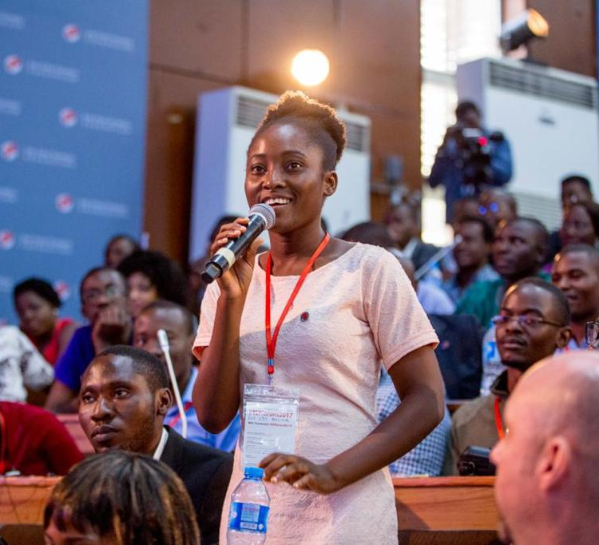





THE SEVEN PILLARS OF THE TEF ENTREPRENEURSHIP PROGRAMME
BUSINESS MANAGEMENT TRAINING
PITCHING COMPETITION
TEF
MENTORING
TEF FORUM
ALUMNI NETWORK & MEET-UPS
TEFCONNECT
NON-REFUNDABLE SEED CAPITAL

Slide 7



A Clear Road Map To Sustainable And High Impact Development Through Entrepreneurship
TRACK RECORD
IMPACT
OPERATIONAL EXCELLENCE
Founded in 2010
Entrepreneurship Programme launched 2015
Strong M&E function and governance structure
Innovative partnerships with EU, IRC, UNDP and others
We reach all 54 African countries
400,000 applicants in 2022
Digital reach of 1m+
Strong focus on gender inclusion and sustainability
Fulfilled and doubled commitment
Trust capital
Digital infrastructure
Bespoke curriculum
M&E
Public sector engagement
Governance

Slide 8



A Clear Road Map To Sustainable And High Impact Development Through Entrepreneurship
TRAINING AND CAPACITY BUILDING
ACCESS TO FUNDING
POLICY DEVELOPMENT & ADVOCACY
Upskilling and training for tomorrow’s world is key.
Climate awareness, digital skills and entrepreneurship as well as sector specific training are all integral pieces of the road map to success.
Innovative funding solutions’ through a blended finance model that takes entrepreneurs from start up to IPO will ensure inclusivity and financial mobility thus democratizing opportunity.
A major coalition pillar is public Sector collaboration to foster an enabling environment which is critical to success. All 54 African Governments as stakeholders with vested interest in the success of beneficiaries from their countries

Slide 9








TEF’s KEY SUCCESS FACTORS
TEF’s vast existing database of high-quality youth entrepreneurs from previous application cycles, and access to tens of thousands additional applications.
A curriculum uniquely designed for this youthful, women inclusive target demography of entrepreneurs across Africa.
An extensive alumni network of over 18,000 previous beneficiaries to serve as peer mentors for support.
Virtual and physical pitching competitions that ensure the selection of the most promising entrepreneurs.
TEF’s robust due diligence framework which will be leveraged to ensure the partnership supports credible youth and their businesses across Africa.
Multiple channels for raising the visibility of our programme and partners.
TEF’s strong partnerships with reputable financial institutions and the extensive infrastructure, local expertise for the seamless disbursement of seed capital.
TEF’s on-the-ground network of youth organisations, agencies, & impact hubs across Africa.

Slide 10
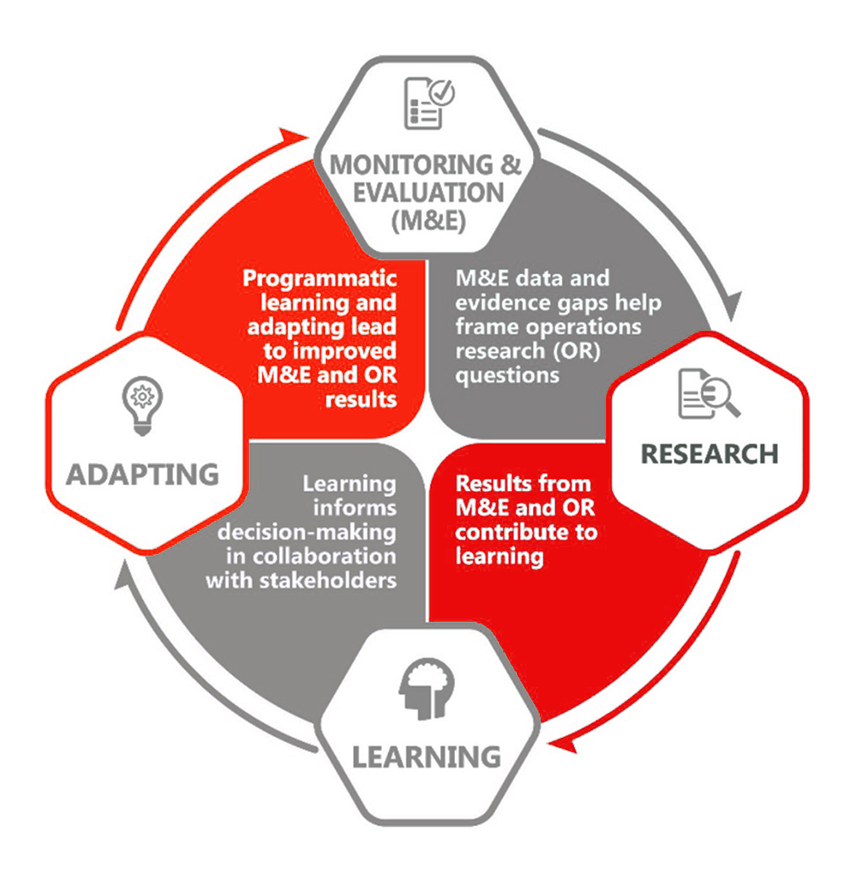
MONITORING FOR RESULTS
Key Performance Indicators
Number of Entrepreneurs trained and funded by the action
Revenue Generated by Funded Businesses
Job created by Funded Businesses
Growth in Annual Revenue
Per capita Growth in Income
Household Impacted Directly and Indirectly by Action
Level of climate literacy, and Adaptability to ecological regeneration amongst supported businesses
TEF MERLA SYSTEM

Slide 11


Slide 12
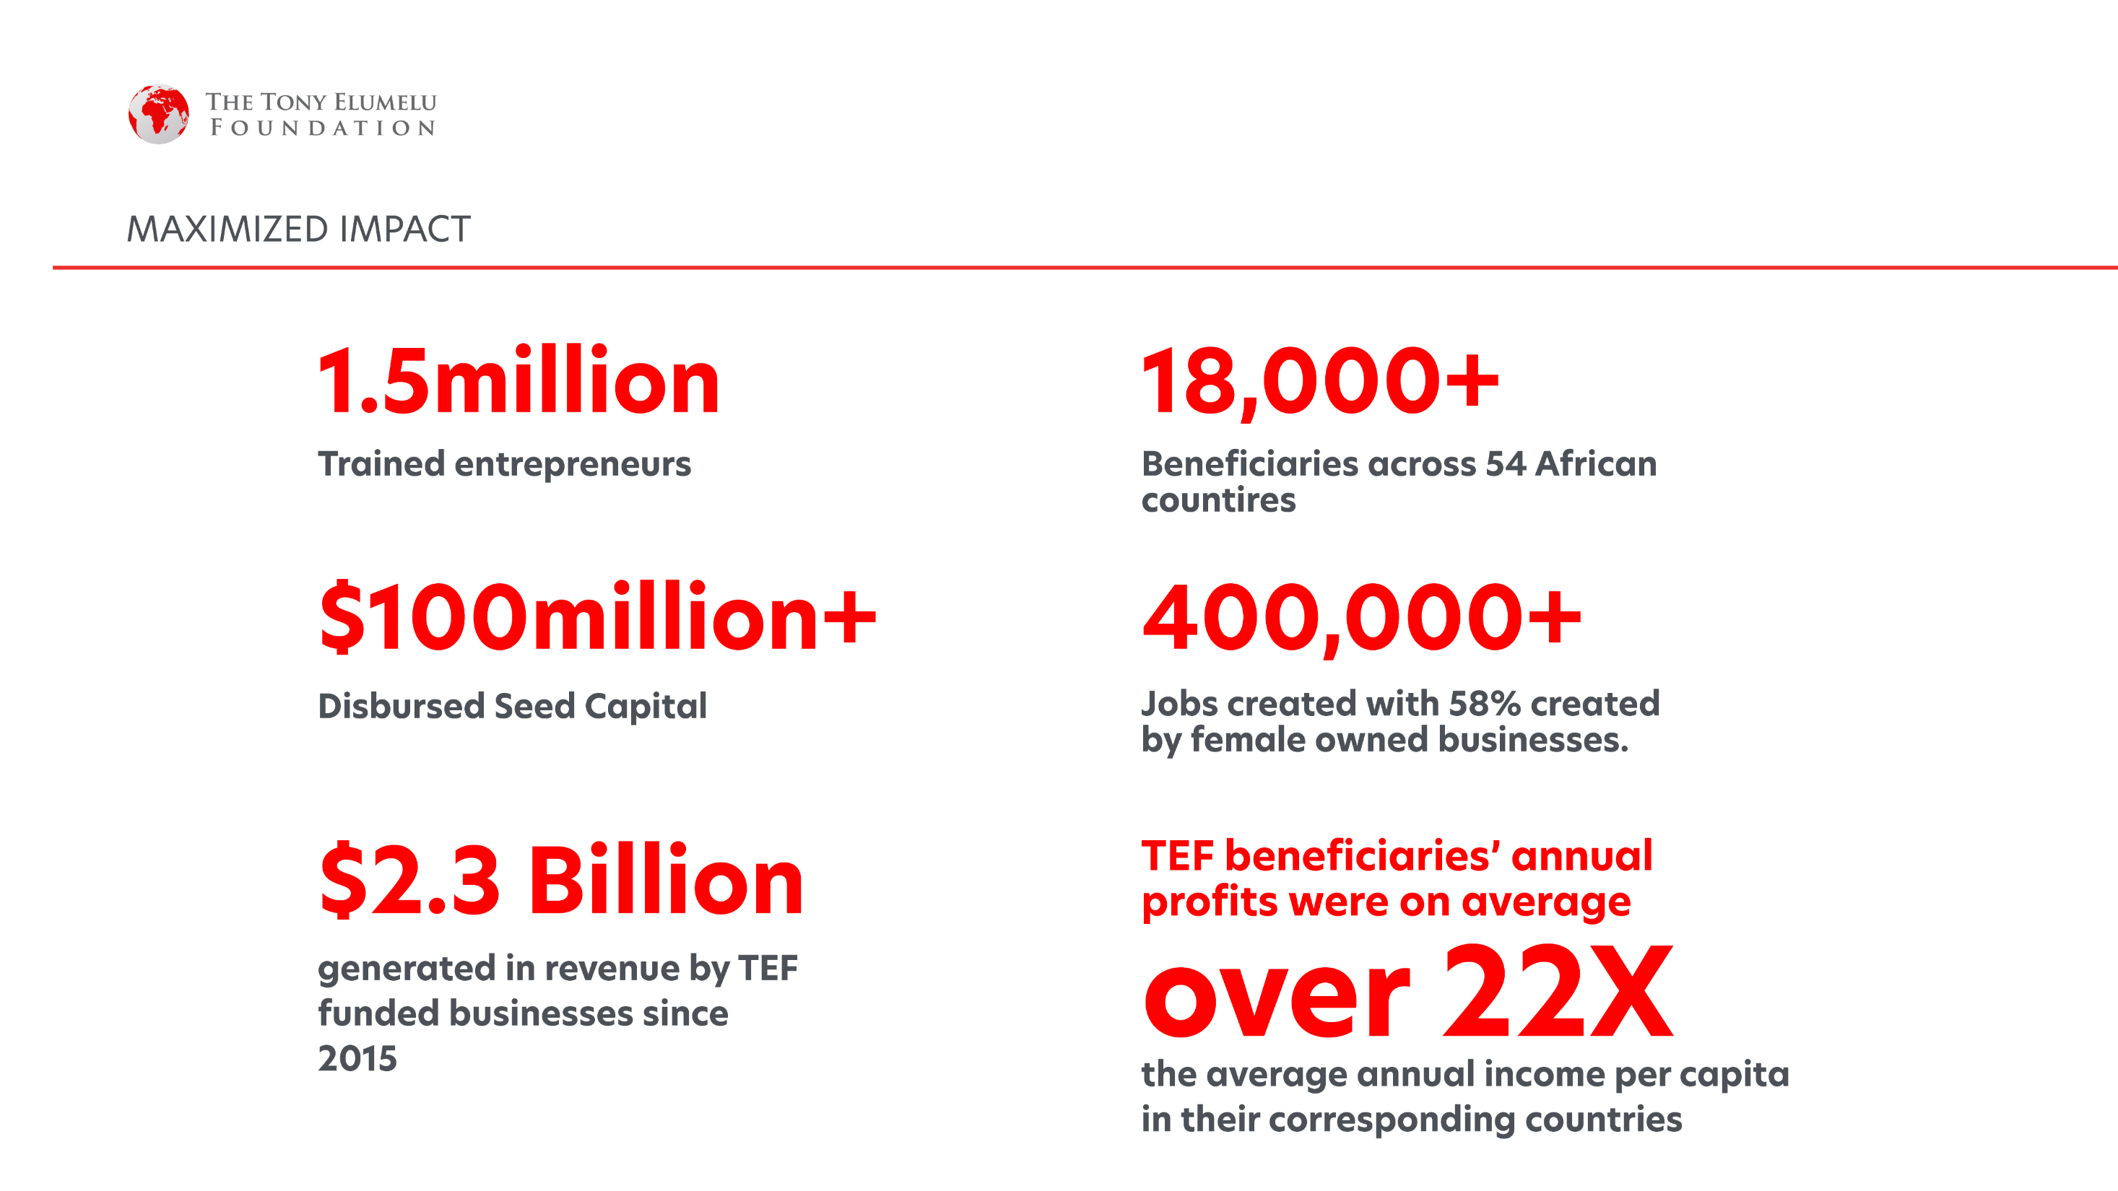
“TEF has affected me positively and has helped and provided me with the knowledge and skills to run a private business successfully and profitably”. Beneficiary from Nigeria
20,000

Slide 13
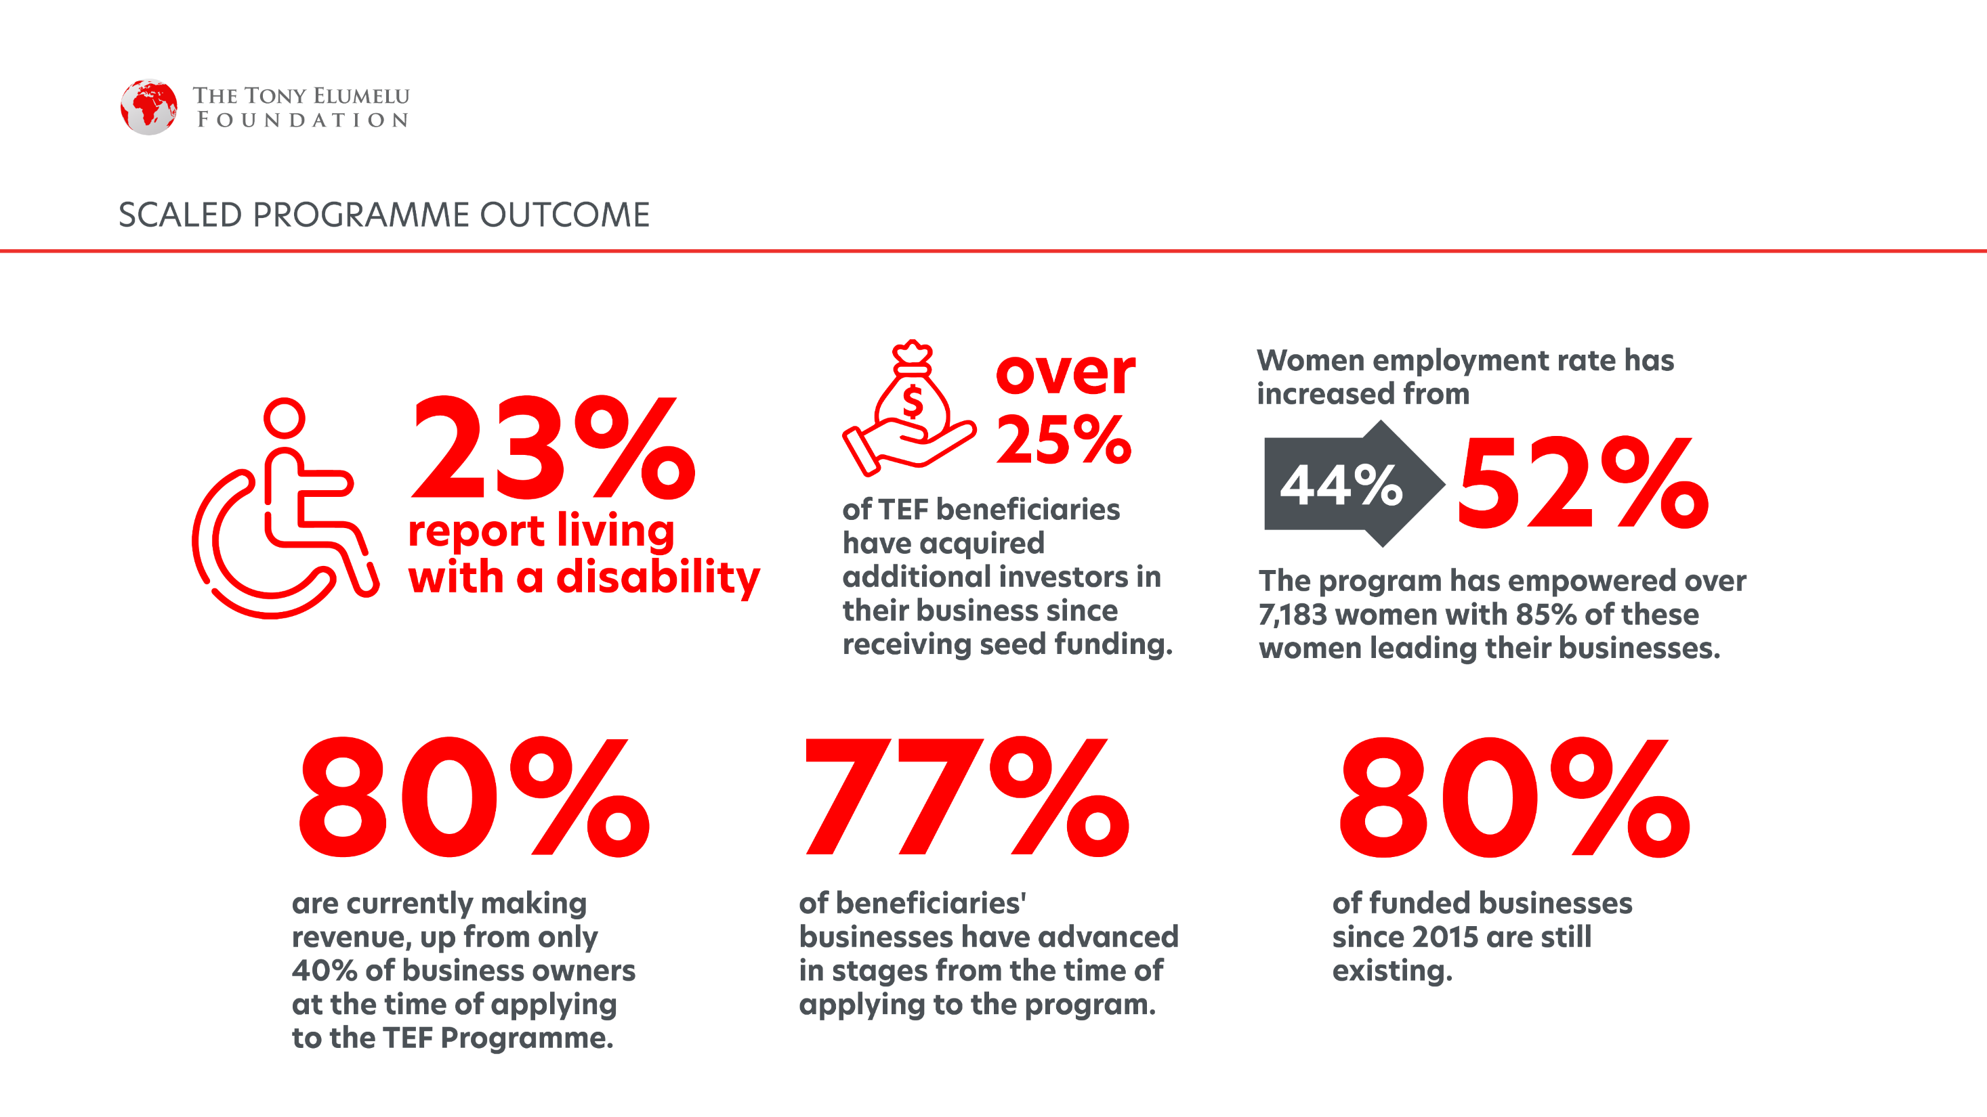

Slide 14
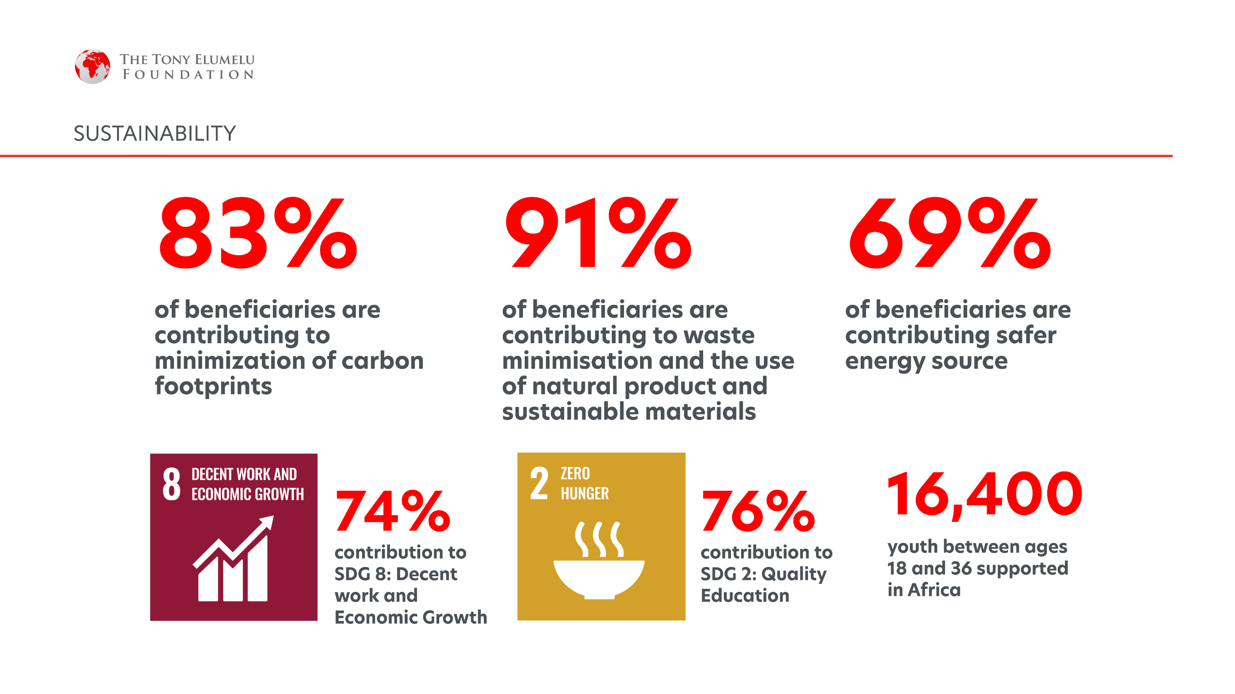

Slide 15


Demonstratable
Impact
Income generation and job creation
Increase in Revenue Created within 2 years of funding on the programme by operational entrepreneurs
Increase in Jobs
Created within 2 years of funding on the programme by operational entrepreneurs
400%
300%
TEF
Increase in monthly revenue by entrepreneurs within 2 years of funding.
TEF
of added jobs was contributed by female-owned businesses
132%
41%
of added revenue was contributed by female-owned businesses
of new jobs added by TEF entrepreneurs are women and mostly between ages 18 - 25.
39%
68%

Slide 16


TEF – Demonstrable Impact
89%
  of MSMEs funded by TEF would have had access to other funding without the programme. Signifying the increasing need to scale the TEF programme
ZERO
98%
of successful entrepreneurs attribute their success to increased business development capacity and increased access to market from the programme
Increased Access to Funding
66% Survival Rate For start-ups and MSMEs
ETF
ENTREPRENEURS
SUCCESS RATE
88%
35% of
TEF Entrepreneurs have had access to second stage Funding to scale their businesses
21%>
  of extra scale-up funding received of the 35% of TEF entrepreneurs came from further partnerships on the TEF programme
  compared to the 45% survival rate for MSMEs in Africa, including Nigeria.

Slide 17




Stories of
Impact!
ALERO THOMPSON
CONSTANCE AYIHOUNOUN
IDAYAT BRIGGS
CHARLOT MAGAYI
is an educationist who is passionate tech education for the girl child.
Alero’s enterprise,
Blue Sands Academy has impacted the lives of over 3000 girls in northern Nigeria and created over 200 jobs.
Is a climate entrepreneur who produces organic fertilizers and pesticides and sells them to agricultural cooperatives and green spaces thus reducing nitrate based emissions
One year after launching her furniture company in a male-dominated industry, with no credit history to qualify for a loan, Idayat was selected by the Foundation. In 2021, her business reached a N100million ($250k) turnover mark, placing her in the league of fastest-growing local furniture manufacturing companies in West Africa.
Mukuru Clean Stoves is a social enterprise in Mukuru the third largest slum-dwelling in Kenya, Charlot has sold over 70,000 clean stoves and impacted over 350,000 individuals with cost effective cooking stoves. 100% of Mukuru clean stoves sales agents are women and 85% of their staff are from the communities which they serve.

Slide 18














Our Partners

Slide 19




PARTNER TESTIMONIALS
Our partnership shows that ultimately African growth cannot neglect the huge potential, creativity, and entrepreneurial spirit that harbours so many Africans. I am extremely glad our partnership is moving into this active stage, and I am very glad that over 2400 women will benefit from the Tony Elumelu Foundation’s training programme.
– Koen Doens, EU Director-General, International Cooperation and Development, European Commission
Our partnership with the Tony Elumelu Foundation on youth entrepreneurship is informed by our belief that Africa will only succeed when young Africans are given the opportunity to excel. This is what has inspired us to invest more than $20 million in emerging African entrepreneurs since we entered into our partnership with the Tony Elumelu Foundation..”
- Director, UNDP Regional Bureau for Africa, Ms. Ahunna Eziakonwa

Slide 20






RESEARCH COLLABORATIONS
Notes:
Impact for the foundation - job creation, women economic empowerment, poverty alleviation

Slide 21
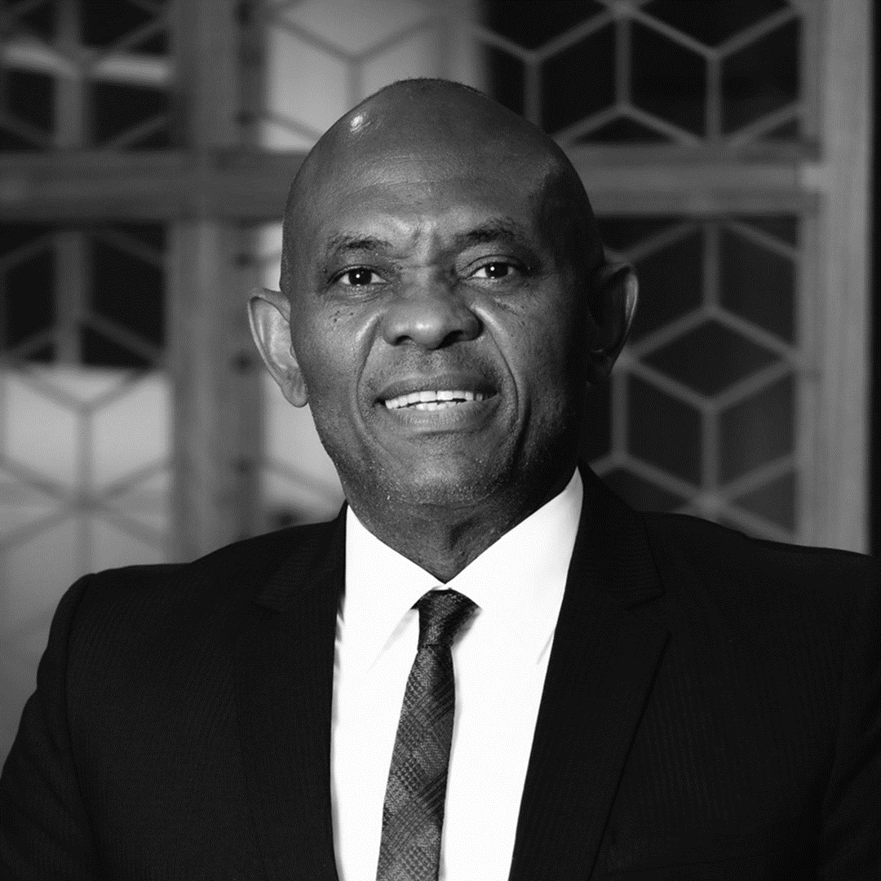
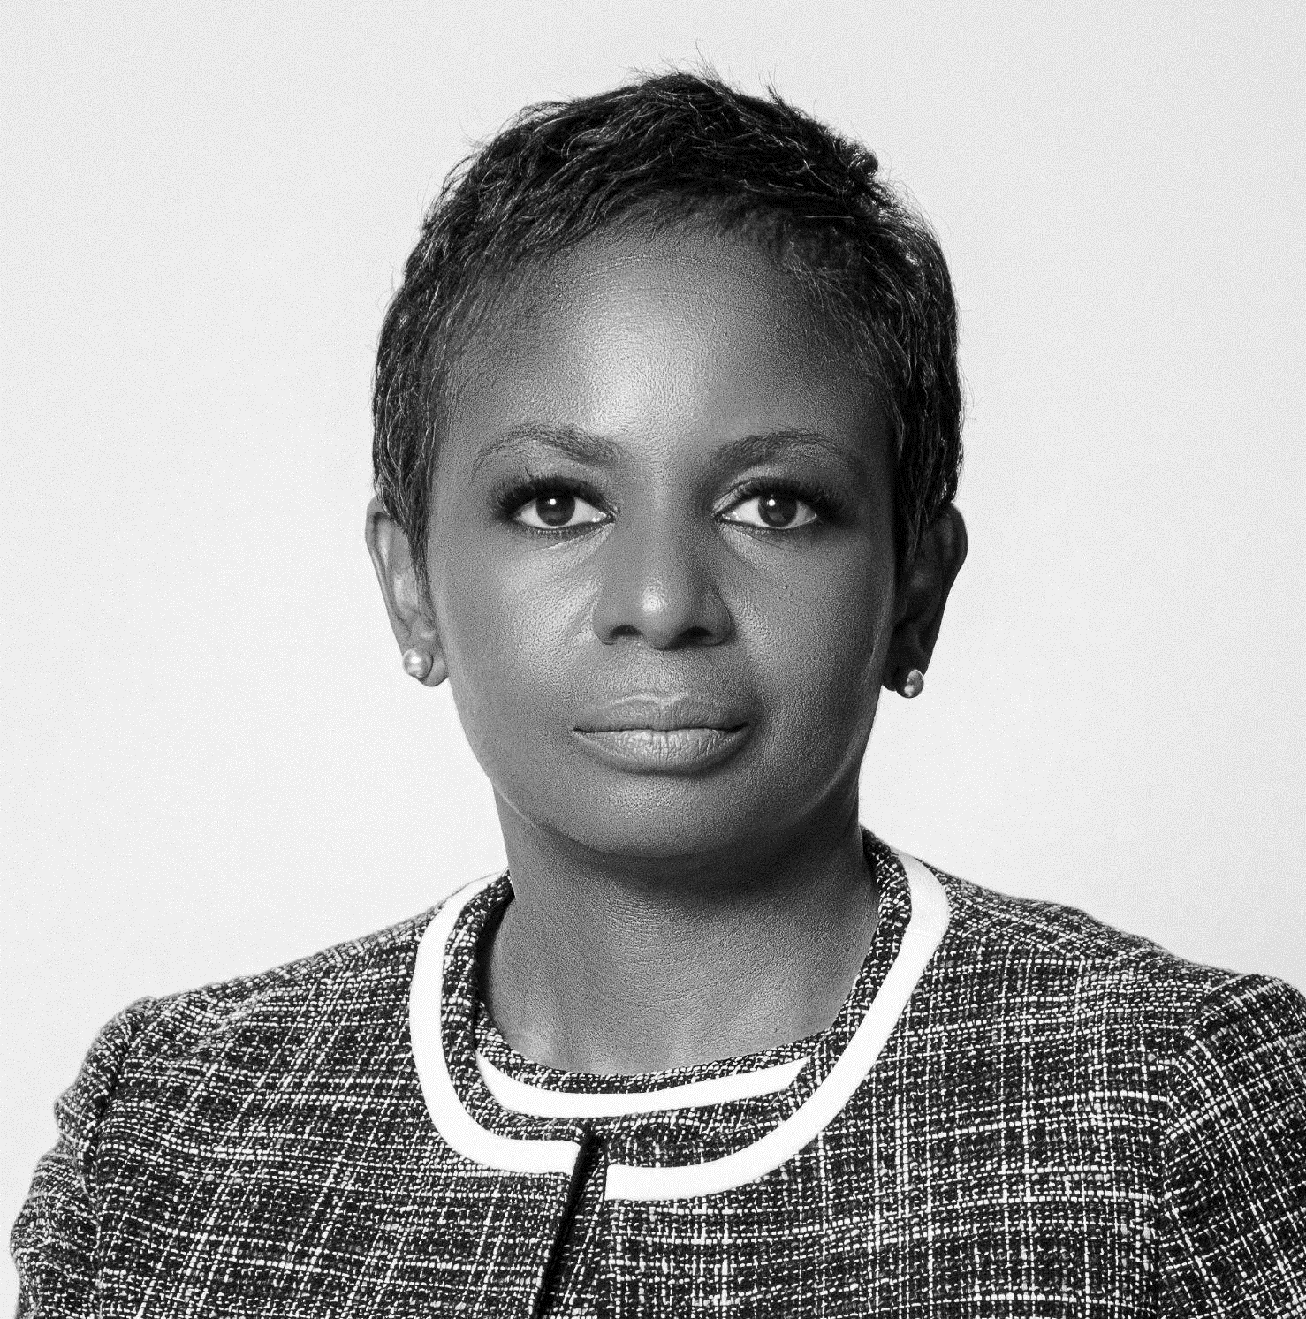


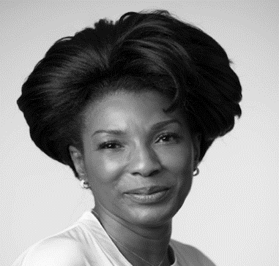

Leadership Team
TEF
TONY O. ELUMELU, CFR
FOUNDER
DR AWELE V. ELUMELU
CO-FOUNDER
ALEXANDER TROTTER
TRUSTEE
LIONEL ZINZOU
ADVISORY BOARD MEMBER
FATOU ASSAH
ADVISORY BOARD MEMBER
SOMACHI CHRIS ASOLUKA
CEO

Slide 22

Over the next 10 years…
In March 2023, the Tony Elumelu Foundation announced its $500 million Coalition for African Entrepreneurs to support 100,000 young African entrepreneurs, by 2033, focusing on fragile states, women’s entrepreneurship, and green entrepreneurship.
This Coalition is open to development agencies, the private sector, philanthropic organisations, and governments, to collaborate in empowering Africa’s next generation.
The Coalition will reinforce the Tony Elumelu Foundation’s role as the leading philanthropy empowering a new generation of African entrepreneurs, driving poverty eradication, catalysing jobs creation across all 54 African countries, and increasing women economic empowerment.

Slide 23

Thank You

